Slide 1

OOP Techniques in a Simple Game
Radu Albastroiu

Slide 2
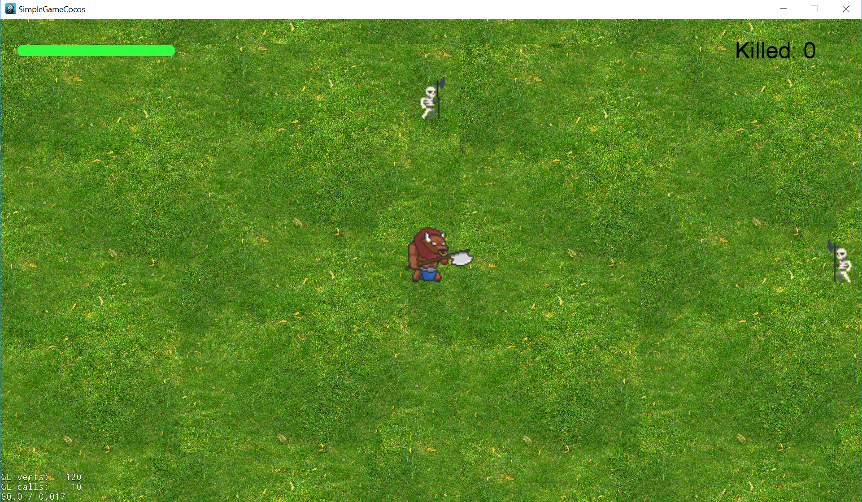
What game?

Slide 3
Where can I see the code for the final version?
This project was developed for this course and you are encouraged to continue working on it or to build a new game based on this foundation.
You can find the repository on GitHub at: https://github.com/RaduAlbastroiu/Minotaur
There are instruction on how to clone and run it, how to start a new project and few tutorials that I found helpful.
For other questions: radu.albastroiu@caphyon.com

Slide 4
Technologies and platforms
Technologies:
C++
Cocos2d-x game engine
Platforms:
Windows
MacOS
Linux
Android
iOS

Slide 5

Cocos2d-x
For this project we will use the Cocos2d-x game engine.
Cocos2d-x because:
Smaller
Easy to use
Cross-platform

Slide 6
Coding - Stage 1

Slide 7
OOP Concepts
These are also called as four pillars of Object Oriented Programming.
Inheritance
Encapsulation
Abstraction
Polymorphism

Slide 8
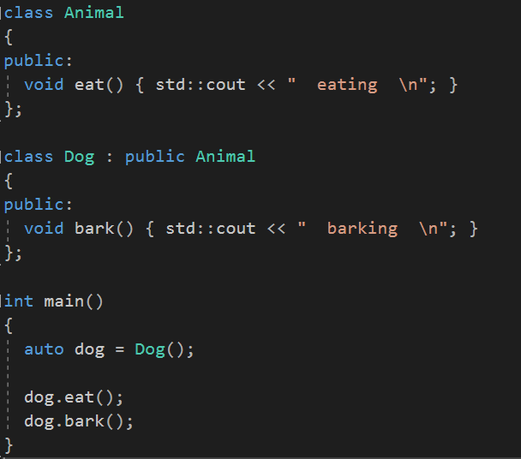
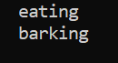
Inheritance
Inheritance expresses is-a/has-a relationship between two objects.
Output:

Slide 9
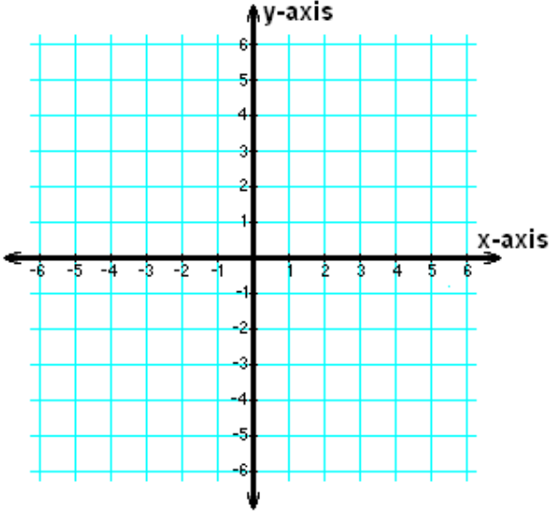
Cocos2d::Scene
Cocos2d game engine is based on nodes.
Scene is a node with the property that its anchor point by default is in the center of the screen.
Cocos2d coordinate system origin is in the bottom left corner of the screen.

Slide 10

Cocos2d::Sprite
Sprite just like the Scene is another Node than can be created using an image using formats like PNG, JPEG, TIFF and others.
Unlike the Scene we need to set its position on the screen.
On a sprite we can do actions like scaling, modifying opacity, changing rotation, changing position, running animations and many other.

Slide 11
Coding - Stage 2

Slide 12
SOLID Principles
SOLID is an acronym for 5 important design principles when doing Object Oriented Programming.
S - Single responsibility principle
O - Open/Closed principle
L - Liskov substitution principle
I - Interface segregation principles
D - Dependency inversion principle

Slide 13
S - Single responsibility principle
In programming, the Single Responsibility Principle states that every module or class should have responsibility over a single part of the functionality provided by the software.

Slide 14
KISS Principle
Keep It Simple, Stupid
Programming languages are for humans to understand, so keep coding simple.
Keep your methods small each method should never be more than 30-40 lines.
Each method should only solve one small problem.

Slide 15
OOP Concepts
These are also called as four pillars of Object Oriented Programming.
Inheritance
Encapsulation
Abstraction
Polymorphism

Slide 16
Encapsulation
Encapsulation is the mechanism of hiding of data implementation by restricting access to public methods.
This Concept is also often used to hide the internal representation, or state, of an object from the outside. This is called information hiding.

Slide 17
Public, Protected, Private
Public class members and functions can be used from outside of a class by any function or other classes.
Protected class members and functions can be used only inside a class or its derived classes.
Private class members and functions can be used only inside of class.

Slide 18
Design patterns
In software engineering, a design pattern is a general repeatable solution to a commonly occurring problem in software design.
Design patterns can speed up the development process by providing tested, proven development paradigms.

Slide 19
Coding - Stage 3

Slide 20
Game Loop
Pretty much every game ever made has a game loop, even if it’s hidden by the game engine.
A Cocos2d-x game is no exception, although it might not be immediately obvious.
If the target frame rate is 60 FPS, then every 16,667 ms the game loop will run once.

Slide 21
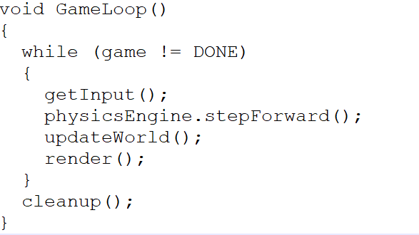
Game Loop
As you can see, it’s quite literally a loop that calls various functions that make you game a game.
This is obviously a primitive example of game loop, but most of them end up looking very similar to this.

Slide 22
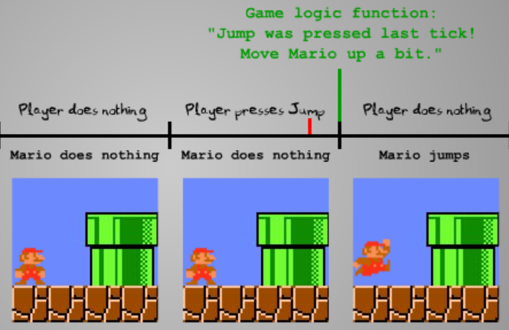
Game Loop
Simple example of a game loop:
Player nothing, Mario nothing
Player presses jump, Mario nothing
Player nothing, Mario jumps

Slide 23
Coding - Stage 4

Slide 24
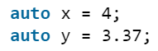
Auto Keyword
Type inference refers to automatic deduction of the data type of an expression in a programming language.
Before C++ 11, each data type needs to be explicitly declared at compile time.
x is of type int
y is of type double

Slide 25
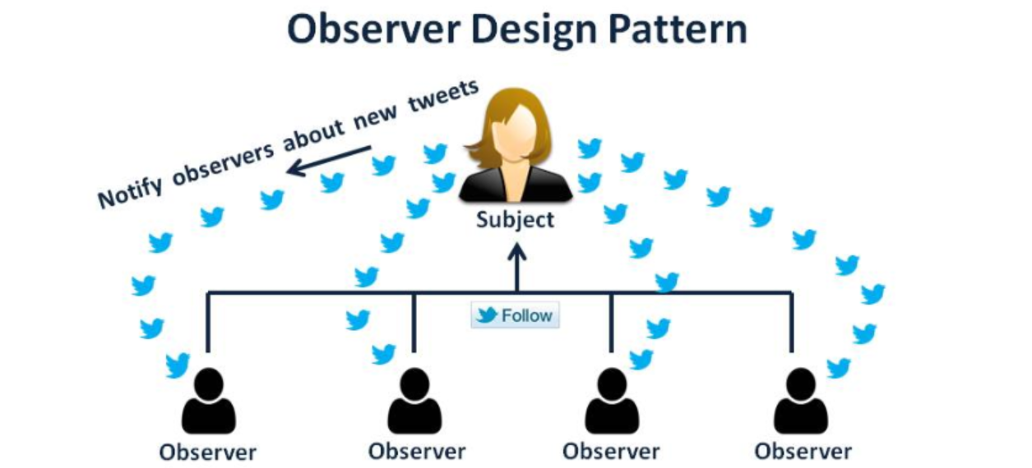
Observer Pattern
Define a one to many dependency between objects so that when one object changes state, all its dependents are notified and updated automatically.

Slide 26
Input
Cocos2d supported event types:
Mouse
Touch
Keyboard

Slide 27
Keyboard Events
Cocos2d lets you to create an event listener that can receive be registered to receive keyboard events.
This process is similar with the Game Loop Update registration, using Observer pattern.

Slide 28
Keyboard Events
What if you wanted to check to see if the spacebar was pressed at any given time?
You can’t, Cocos2d-x is entirely event based.
There is a work around:
When a key is pressed we store it in a std::map using KeyCode and current time
When the key is released, we remove the released key from the map.
Therefore at any given time, we know which keys are pressed and for how long.

Slide 29
Std::Map
Map is a sorted associative container that contains key-value pairs with unique keys.
Operations:
Insert a pair of values (key, value) in a map
Find a pair of values using only the key.
Iterate through the map
Erase a pair of values using only the key.

Slide 30
Register Keyboard Events
To register key pressed we have to provide implementation for the event listener for the OnKeyPressed.
The same for key released using OnKeyReleased.
How we can provide implementation? Using a lambda function.

Slide 31
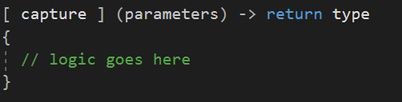
Lambda Function
Simply put a lambda function is a function without a name, an inline function, which can be used for short snippets of code that are not going to be reuse and not worth naming. Lambda expression can be defined as:

Slide 32
Coding - Stage 5 - 6

Slide 33
Questions

Slide 34
End of part 1

Slide 35
Hello Again
Radu Albastroiu

Slide 36
What we learned so far?
What is Inheritance
S from SOLID principles
KISS - Keep It Simple, Stupid
Encapsulation
Observer Pattern
Lambda function

Slide 37
What we built so far?
Static background, health label, static score
Hero sprite
Keyboard listener
Move Hero using the keyboard listener, without going outside the screen

Slide 38
Refactoring
Code refactoring is the process of restructuring existing computer code.
Benefits:
Maintainability, easier to solve bugs
Extensibility, it is easier to extend the capabilities of the application

Slide 39
DRY - Principle
Don’t Repeat Yourself
Just Don’t

Slide 40
Coding - Stage 7 - 10

Slide 41
Stage 6 vs Stage 10
What’s the difference ?
It does the same thing almost.
Let’s see the roles of objects in stage 6 and after the refactor in stage 9.

Slide 42
Stage 6 vs Stage 10
AppDelegate - Create Scene
MainScene - Init Hero, Background, HealthBar, ScoreLabel, Keyboard
MainScene - Update Hero
MainScene - Move Hero
MainScene - Interogate keyboard
MainScene - Update Health Bar
AppDelegate - Create Scene
MainScene - Init Hero, Background, HealthBar, ScoreLabel, Keyboard
MainScene - Update Hero

Slide 43
Coding - Stage 11

Slide 44
OOP Concepts
These are also called as four pillars of Object Oriented Programming.
Inheritance
Encapsulation
Abstraction
Polymorphism

Slide 45
Abstraction
A concept or an Idea which is not associated with any particular instance.
Abstraction is achieved in C++ using Pure Abstract Classes.
A pure abstract class is a class without implementation or members from which another object will inherit.
A frequently used therm in other languages is Interface.

Slide 46
OOP Concepts
These are also called as four pillars of Object Oriented Programming.
Inheritance
Encapsulation
Abstraction
Polymorphism

Slide 47
Polymorphism
Greek word for one name many forms
There are 2 types of polymorphism static and dynamic
Static achieved by using Method Overloading
Dynamic achieved by using Method Overriding

Slide 48
Coding - Stage 12

Slide 49
Updates

Slide 50
Slides on github

Slide 51
Stages on github

Slide 52
Questions

Slide 53
End of part 2

Slide 54
Hello Again
Radu Albastroiu

Slide 55
What we learned so far?
What is Inheritance
Single Responsibility Principle
KISS - Keep It Simple, Stupid
Encapsulation
Observer Pattern
Lambda function
DRY - Don’t repeat yourself
Abstraction
Polymorphism

Slide 56
What we built so far?
Static background, health label, static score
Hero sprite
Keyboard listener
Move Hero using the keyboard listener, without going outside the screen
Keyboard profiles
Refactored all code, the 2 heros example

Slide 57
What we have for today

Slide 58
Memory management

Slide 59
But first

Slide 60



Animations

Slide 61

Sprite Atlas
A set of in a single png file.
A sprite atlas an associated xml or plist file with information about the position of each sprite in that file.

Slide 62
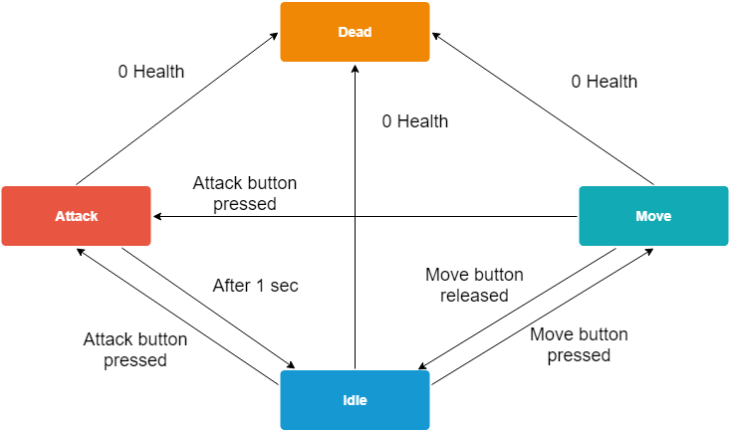
State machine

Slide 63
Coding - Stage 13-17

Slide 64
Memory Management

Slide 65
Further Work

Slide 66
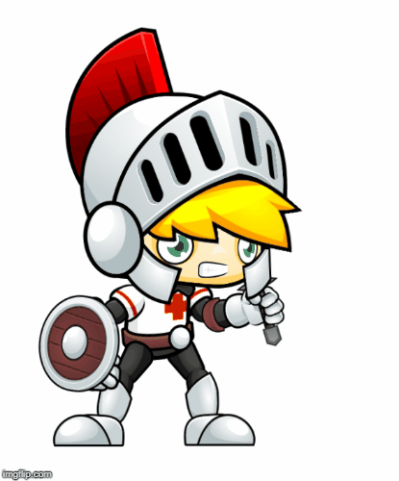
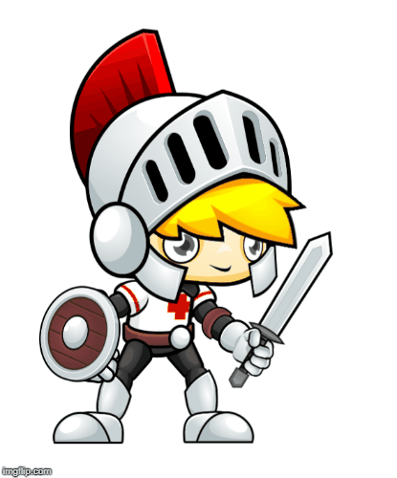
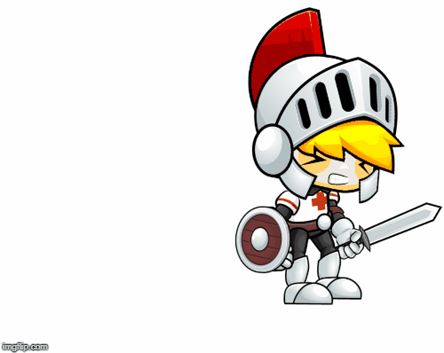
Create a new enemy type.
More health
Faster
Stronger
Different spawn locations

Slide 67
Where I send my project?
Send your project at: open4tech@caphyon.com
You can find the repository on GitHub at: https://github.com/RaduAlbastroiu/Minotaur
There are instruction on how to clone and run it, how to start a new project and few tutorials that I found helpful.
For other questions: radu.albastroiu@caphyon.com

Slide 68
Thank you.

